Slide 1

Advanced x86: BIOS and System Management Mode Internals System Management Mode (SMM)
Xeno Kovah && Corey Kallenberg
LegbaCore, LLC

Slide 2
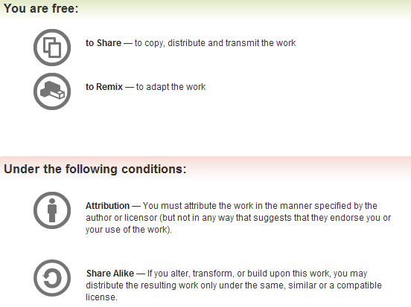
All materials are licensed under a Creative Commons “Share Alike” license.
http://creativecommons.org/licenses/by-sa/3.0/
Attribution condition: You must indicate that derivative work
"Is derived from John Butterworth & Xeno Kovah’s ’Advanced Intel x86: BIOS and SMM’ class posted at http://opensecuritytraining.info/IntroBIOS.html”
Notes:
Attribution condition: You must indicate that derivative work
"Is derived from John Butterworth & Xeno Kovah’s ’Advanced Intel x86: BIOS and SMM’ class posted at http://opensecuritytraining.info/IntroBIOS.html”

Slide 3
System Management Mode (SMM)
God Mode Activate

Slide 4
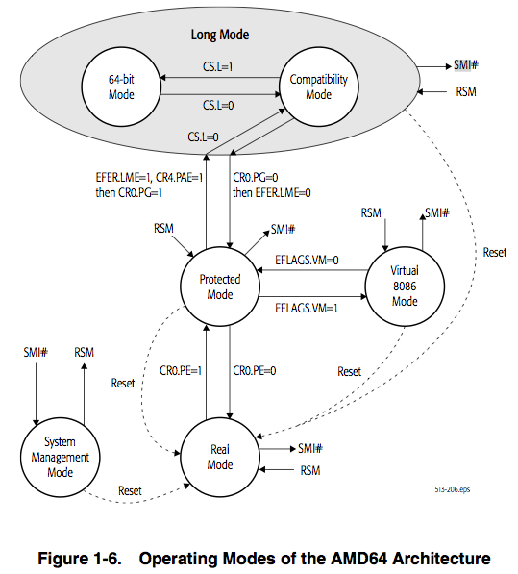

Batteries Not
Included!
From http://support.amd.com/us/Processor_TechDocs/24593.pdf
Notes:
http://www.explore-science-fiction-movies.com/images/fix-its-batteries-not-included-nest.jpg

Slide 5
System Management Mode (SMM) Overview
Most privileged x86 processor operating mode
Runs transparent to the operating system
When the processor enters SMM, all other running tasks are suspended
SMM can be invoked only by a System Management Interrupt (SMI) and exited only by the RSM (resume) instruction
Intended use is to provide an isolated operating environment for
Power/Battery management
Controlling system hardware
Running proprietary OEM code
etc. (anything that should run privileged and uninterrupted)

Slide 6
System Management Mode (SMM) Overview
The code that executes in SMM (called the SMI handler) is instantiated from the BIOS flash
Protecting SMM is a matter of protecting both the active (running) SMRAM address space but also protecting the flash chip from which it is derived
Protect itself (SMBASE (location), SMRAM Permissions)
Write-Protect Flash
So far in our research, only about 5% of SMRAM configurations were directly unlocked and vulnerable to overwrite
However, since > 50% of the BIOS flash chips we've seen are vulnerable, that means > 50% of SMRAM will follow suit

Slide 7
System Management Interrupt (SMI)
SMM can only be invoked by signaling a System Management Interrupt (SMI)
SMI’s can be received via the SMI# pin on the processor or through the APIC bus
SMI’s cannot be masked like normal interrupts (e.g. with the “cli” instruction, or clearing the IF bit in EFLAGS)
SMI’s are independent from the normal processor interrupt and exception-handling mechanisms
SMI’s take precedence over non-maskable and maskable interrupts
Including debug exceptions and external interrupts
If a SMI and NMI occur at the same time, only the SMI will be handled

Slide 8
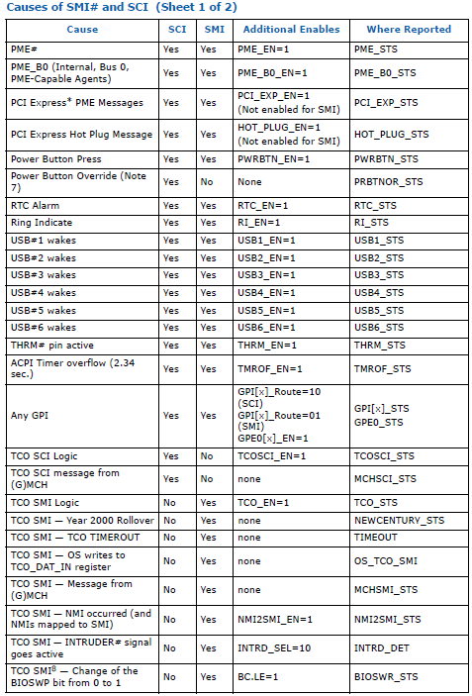
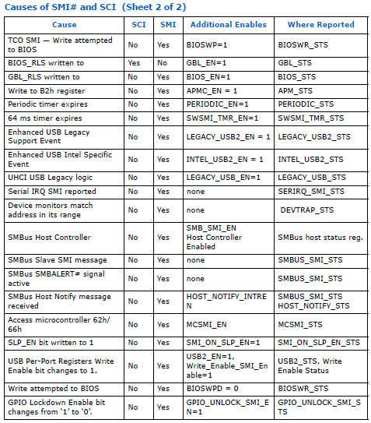
Causes of SMI#
Just an example, your ICH/PCH will list them for your system
Notes:
SCI are interrupts for ACPI, not part of this class

Slide 9
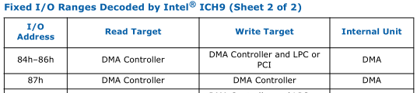
Generating SMI: APM
This is applicable to systems that support Advanced Power Management (most do these days)
Fixed I/O range, so it cannot be relocated
Check your I/O Controller Hub datasheet to verify its supported
Writes to 0xB3 do not trigger an SMI#, only the write to 0xB2
0xB3 can be used to pass information

Slide 10
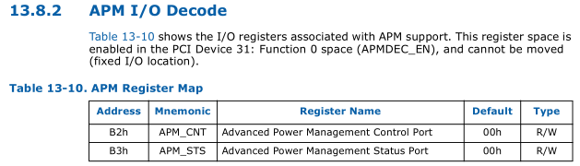
Advanced Power Management (APM)
APM_CNT (0xB2) is the control register
APM_STS (0xB3) is the status register
Located in I/O Address space
Registers are R/W
Note: APM != ACPI, but even on other systems which use ACPI 2.0, this still triggers an SMI#
The PCH datasheets (up to 8-series) also still list these under the fixed IO address
Notes:
Check PCH and include location, if different, otherwise note its static location. Its in LPC so it should be the same

Slide 11
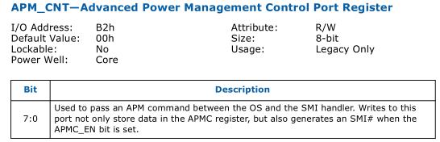
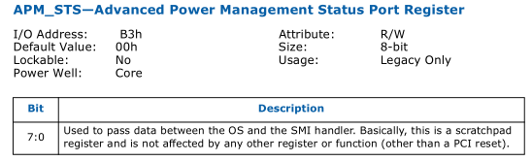
APM_CNT & APM_STS
Writing a byte to port 0xB2 will trigger an SMI#
Writing to 0xB3 does NOT trigger SMI#
Can be used to pass information to the SMI handler.
Control flow through the SMI handler can be determined by the values in ports B2 & B3h
Usage: Could tell the SMI handler to measure Hypervisor memory, or initiate a BIOS update

Slide 12
Examples
Generates SMI. SMI handler can read port 0xB2 to see that 0x12 was passed.
OUT 0xB2, 0x12
Writes 0x34 to 0xB3 and 0x12 to 0xB2 all in one shot (Generating SMI).
MOV DX, 0x1234
OUT 0xB2, DX
Writes 0x34 to 0xB3 and then writes 0x12 to 0xB2. SMI is triggered only on the write to 0xB2.
OUT 0xB3, 0x34
OUT 0xB2, 0x12

Slide 13
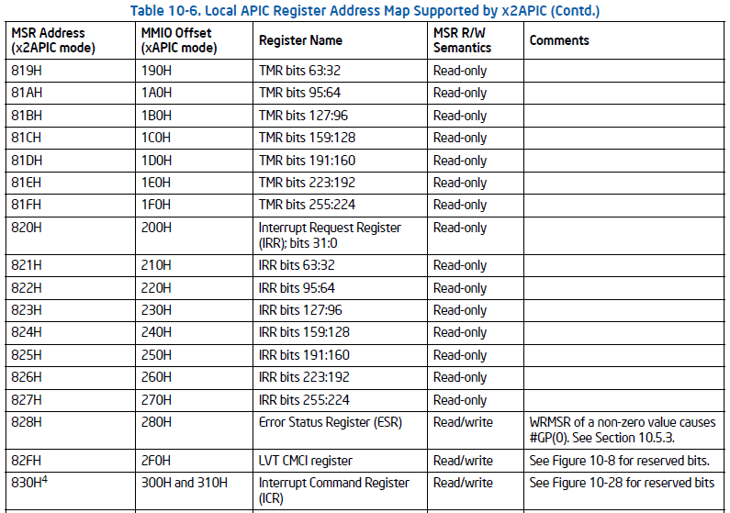
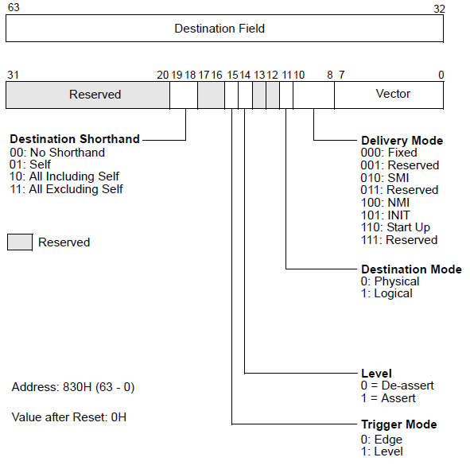
Generating SMI via APIC
We've not yet had time to play with this
Should be able to generate SMI by programming the Interrupt Command Register in the APIC
Architecture (and APIC type) dependent
There is also a Self IPI register

Slide 14
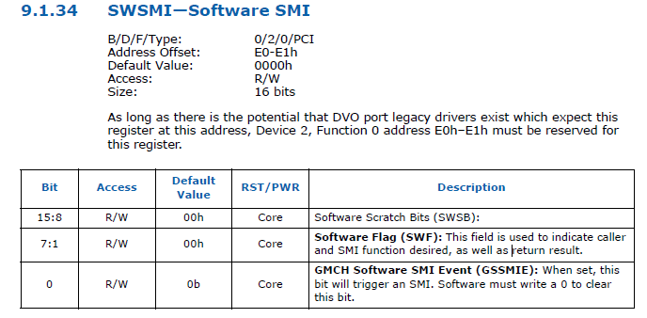
“Corollary” SMI# generation
Looking through the datasheets there are various (too many to show) register/bit-combinations that will also generate an SMI
John called this a “corollary” SMI#. The SMI# is correlated with software is setting a register bit

Slide 15
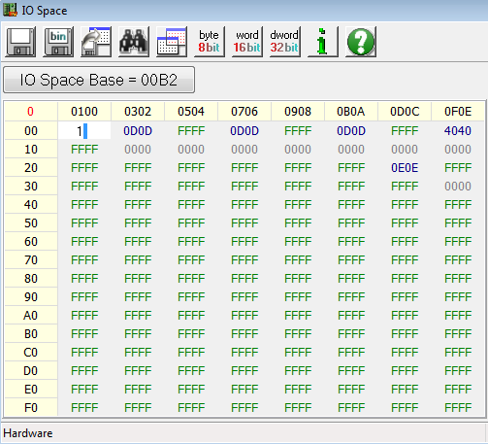
SMI invocation example
Open a port IO window in RW-E at address 0xB2
Type in the number 1 and hit enter
I choose 1 because I know it to be a ‘safe’ value to enter
Notice anything?
(You’re not supposed to)
The system just transitioned into SMM, executed code, and then exited SMM

Slide 16
SMI invocation counter
So we’ve seen that there are a lot of events that can generate SMI and we’ve generated some on our own as well
One logical question is: how frequently are these generated?
As always, the answer is “it depends”
On a system like a laptop, SMM will likely be called frequently to check the battery/power status
Should be an SMI# in that case
But on a desktop it may be called much less frequently

Slide 17
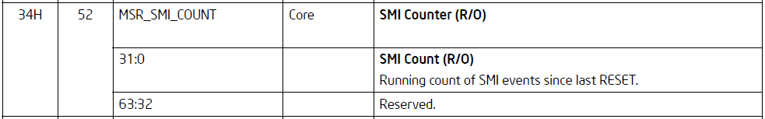
SMI counter (MSR)
Nehalem (Core i series & Xeon) and later architectures only!
And as if answering my wishes for some way to track how frequently SMM is entered, I found this in Intel’s Software Programming Guide (Chapter 35, MSRs)
It’s only available on Nehalem and later processor families (new stuff)
Trying to read this will crash any system that doesn’t support it
I hope you read this before trying ;)
From Intel Vol. 3. Ch. "Model Specific Registers (MSRs)"

Slide 18
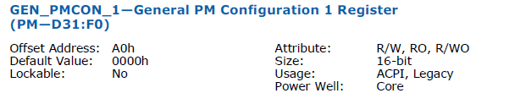
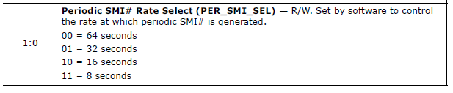
Periodic SMI#
More as a side note (but related to the SMI counter), SMI# can be configured to fire periodically
This way it can be guaranteed that SMI will be generated at least once every 8, 16, 32, or 64 seconds
This register is R/W and resides on the LPC bus (D31:F0, offset A0h, bits 1:0)

Slide 19
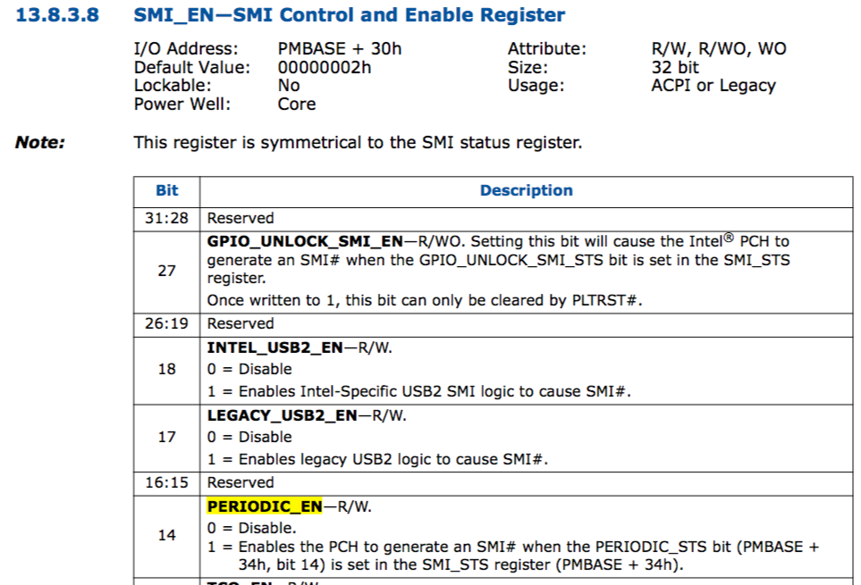

Slide 20
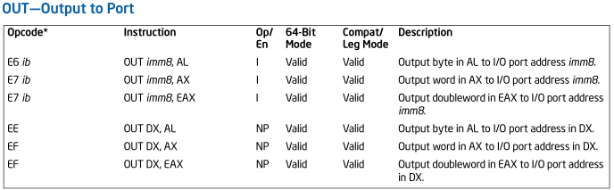
Reversing tip: searching for SMI communication byte patterns
From Intel Vol. 2
You can search for instances where a program is communicating with SMM via port IO by searching for byte patterns like those above
To locate triggering of SMI via port 0xB2, you can search for the bytes “E6 B2” and “E7 B2” in IDA Pro
Single byte searches for EE and EF yield many false-positives so analyze the code before it to ensure that the DX register contains B2
You can also script IDA to create IDB files for all binaries in a folder, and then search within those binaries for “out 0B2h,”

Slide 21
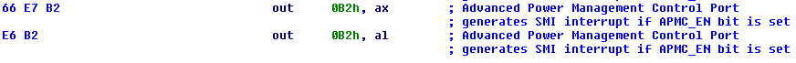
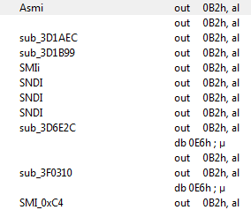
SMI byte patterns example
Searching for instances of “E6 B2” and “E7 B2” in IDA will yield a list of examples like that on the left
Most importantly, IDA provides an interesting clue here to a problem that we’ll be covering shortly…
And is actually the only reason this slide is included

Slide 22
Entering SMM
When receiving an SMI, the processor waits for all instructions to complete and stores to complete
SMI interrupts are handled on an architecturally defined “interruptible” point in program execution
Like an instruction boundary:
XOR EAX, EAX
ADD EAX, 1
Architecturally “interruptible” point
Processor saves the context in SMRAM and begins executing the SMI Handler
In a multi-core processor, no SMI handler code is executed until all cores have performed the above and entered SMM

Slide 23
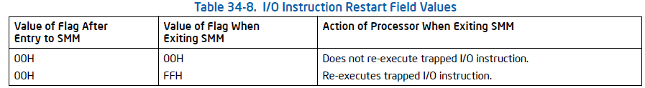
Entering SMM due to IO
From Intel Vol. 3. Ch. "System Management Mode"
IO Instruction restart field is located in the state save area in SMRAM
SMBASE + 8000 + 7F00h
If an IO instruction to a device triggers an SMI, the SMI handler has the option of re-executing that instruction upon returning from SMM
Example: If a device is asleep, port IO to it may generate SMI#. The SMI handler can then wake up the device and re-execute the instruction that generated the original SMI#

Slide 24

Exiting SMM: RSM
From Intel Vol. 2
The only way to exit SMM is through the RSM instruction
Or system reset/shut down
Returns control to the application program or operating-system procedure that was interrupted by the SMI
The processor’s state is restored from the save state area within SMRAM. If the processor detects invalid state information during state restoration, it enters the shutdown state.
The operating mode the processor was in at the time of the SMI is restored.
RSM can only be executed from within SMM
So if you see this, you are debugging the SMRAM code
RSM multi-byte opcode is: 0x0F 0xAA
Executing RSM while not in SMRAM generates an invalid opcode exception

Slide 25
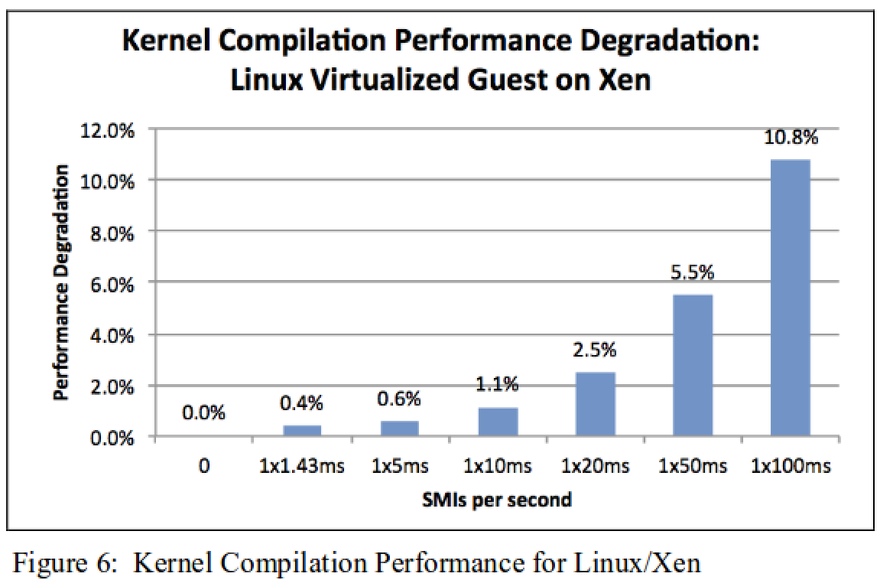
“Performance Implications of System Management Mode”
Here’s a good paper which pushes back against all the academic researchers who act like they can just implement all their security features in SMM
http://web.cecs.pdx.edu/~karavan/research/SMM_IISWC_preprint.pdf

Slide 26
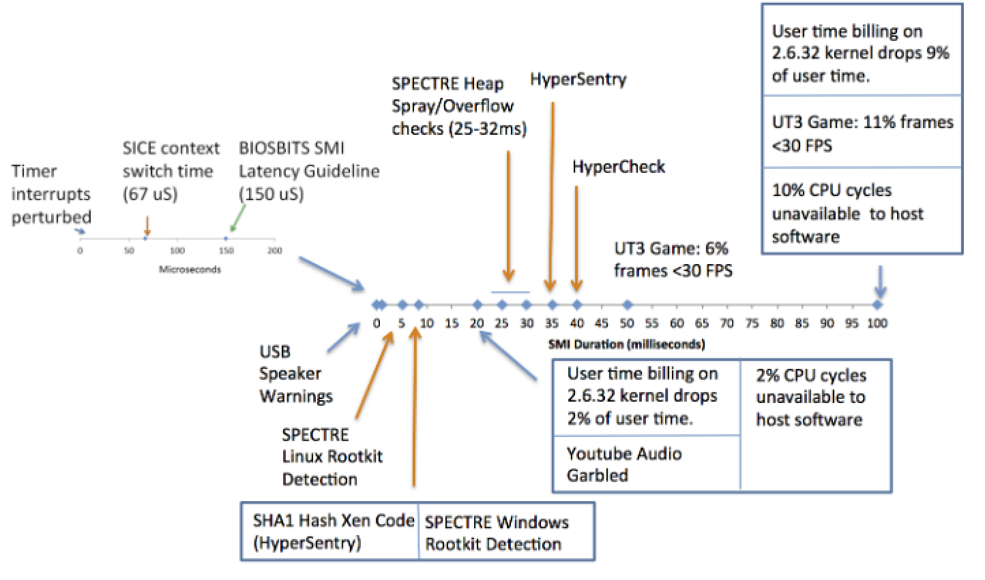
“Performance Implications of System Management Mode” 2

